Slide 1
THERMAL CONDUCTIVITY OF WOOD-BASE FIBER AND PARTICLE PANEL MATERIAL

Slide 2
THERMAL CONDUCTIVITY
Physical property that defines the ability of a substance to conduct heat.
Represented by k
Unit – W/mK
Thermal conductivity of a material depends upon its state and it is a function of pressure , temperature , humidity and structure.
It can be determined experimentally by measuring rate of heat and temperature gradient in the given material.

Slide 3
Order of conductivity
Pure metals
Insulating materials
Inorganic liquids
Gases and vapours
Metals – motion of free electrons
Insulators -porous structure and air pockets
Gases - negligible molecular interaction

Slide 4
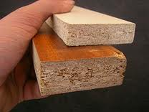
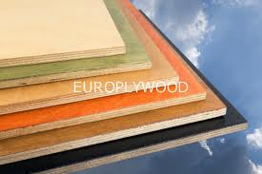
Wood base materials
Fiberboard is a type of engineered wood product that is made out of wood fibers.
Fiberboard is sometimes used as a synonym for particle board, but particle board usually refers to low-density fiberboard.
Plywood is not a type of fiberboard, as it is made of thin sheets of wood, not wood fibers or particles.

Slide 5
Why Thermal insulators ?
Wood is a porous material which is a combination of solid substance and air pockets (voids).
The resistance of the material and the presence of air pockets which act as typical thermal insulation is the primary cause behind the behavior of wood as an inefficient conductor.

Slide 6
DENSITY AND CONDUCTIVITY RELATIONSHIP
Presence of air pockets in wood and wood base materials make them inefficient conductors.
Greater the number of air spaces , lesser is its thermal conductivity. Conversely , lesser the number of air spaces, greater is its conductivity.
Low density wood materials have low conductance and high density wood materials have high conductance.

Slide 7
WOOD BASE FIBER AND PARTICLE PANEL MATERIALS
Panel products are obtained by reconstituting and breaking down wood into small components and putting them together again.
The arrangements of small airspaces is different as are the densities.

Slide 8
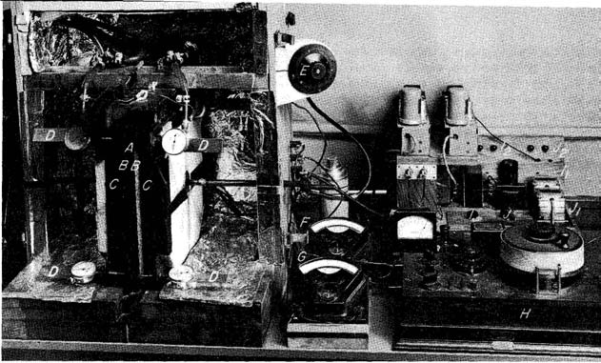
APPARATUS FOR MEASURING THERMAL CONDUCTIVITY

Slide 9
Forest products laboratory guarded hotplate apparatus
Construction
Refrigerating unit , with coils immersed in an insulating tank
Pump for supplying coolant to cold plates
Two identical specimens are sandwiched between the hot plate and the cold plates.

Slide 10
Measurement calibration
To determine the conductivity , the principle is to set a Steady state heat flow conditions between hot plate and cold plate so that there is no lateral heat flow
The standard method requires that the temperature difference between the hot and cold side of the specimen be atleast 10 °f and for good insulators it is recommended to be 40°f.
Conductivity vary with mean temperatures. Higher the mean temperature , higher will be the conductivity. Therefore measurements are made at three different mean temperatures.

Slide 11
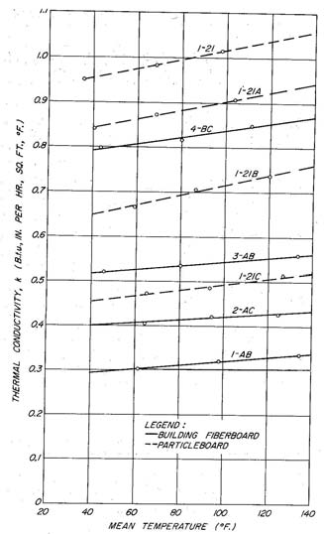
Plot of thermal conductivity values obtained for various mean temperatures for the specially fabricated building fiber-boards and particleboards.

Slide 12
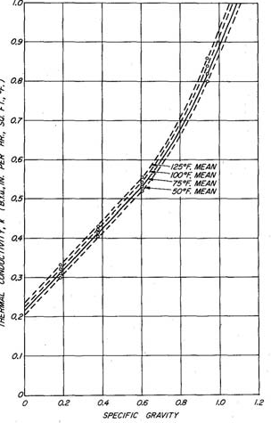
Thermal conductivity-specific gravity relationship for special building fiberboard made without additives.

Slide 13
Effect of additives
Special medium – density hardboard sidings with abnormal additives of resinous materials had greater thermal conductivity values than boards of same density with normal amounts of additives.
Such products are normally manufactured with a density of 40 pounds per cubic foot or less. On that basis, estimated design k equals about 0.65
This is in line with medium density hardboard whose estimated design k equals 0.73 for a maximum density of 50 pounds per cubic foot.

Slide 14
Conclusion
Design curves were developed for thermal conductivity of each type of material based on the specific gravity
It was found that changes in conductivity with mean temperature is significant , however density is a not greatly dependent factor at mean temperatures other than 75°f
The slope of denser products is not consistently steeper than the high density products.
Therefore for conditions other than mean temperature, values were presented which modify thermal conductivity factors
Conductivity values for fiberboards should be increased or decreased 0.00053 B.t.u inch per hr sq foot °F for each degree increase or decrease in mean temperature.
Similar factor for particle board is 0.00093 B.t.u inch per hr sq foot °F .

Slide 15
Thank you

